Slide 1
A Permanent Magnet DC Motor in Magnetic Domain
Sadettin Karaman

Slide 2
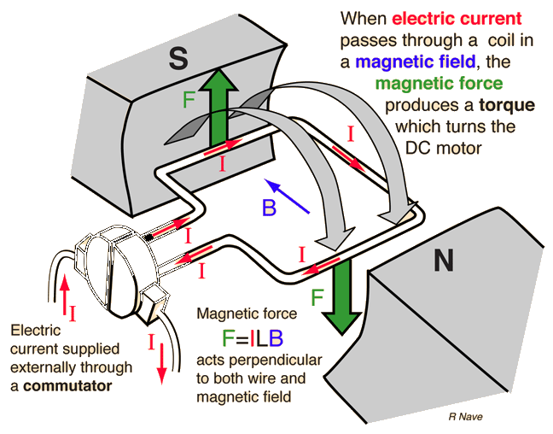
When you search,
The common result is,
A simple DC motor with a single conductor loop
In a fixed magnetic field which doesn’t get affected from the magnetic field generated by conductor loops
Explained according to principles of Lorentz Law.

Slide 3
In order to explain it completely,
We need to consider,
Magnetic force created by each magnet on the rotating conductor loops,
Magnetic force created on each conductor loop by other rotating conductor loops,
How commutator changes the polarity (direction of the current flow) of each conductor loop in time.
For each case it’s necessary to,
Define the closed geometry that created by magnets,
Define the placement of conductor loops,
Define polarity functions that ties the placement of each magnet and position of each conductor loop.

Slide 4
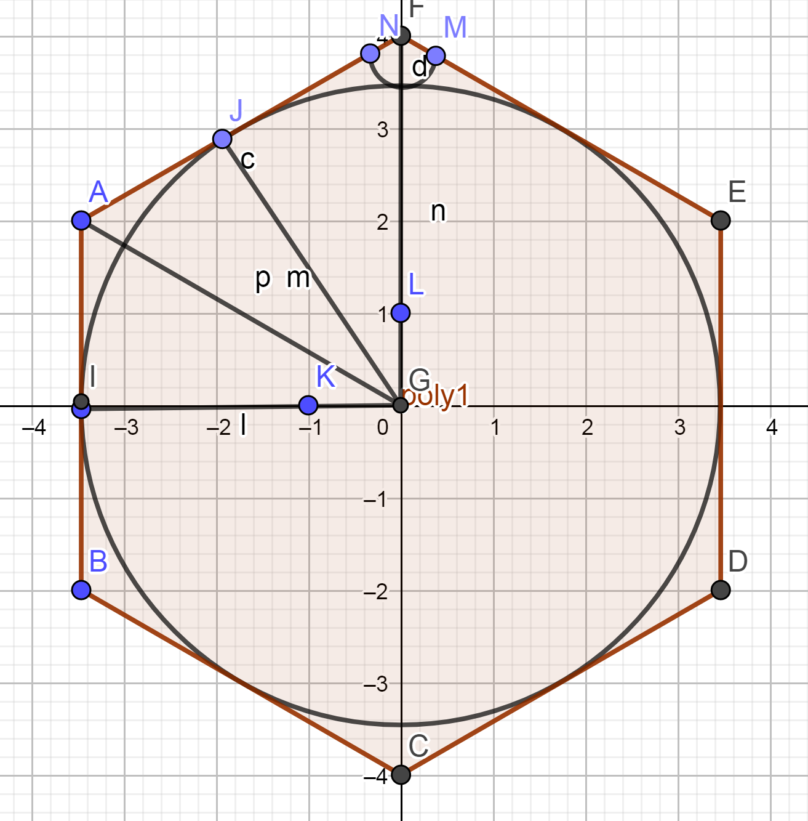
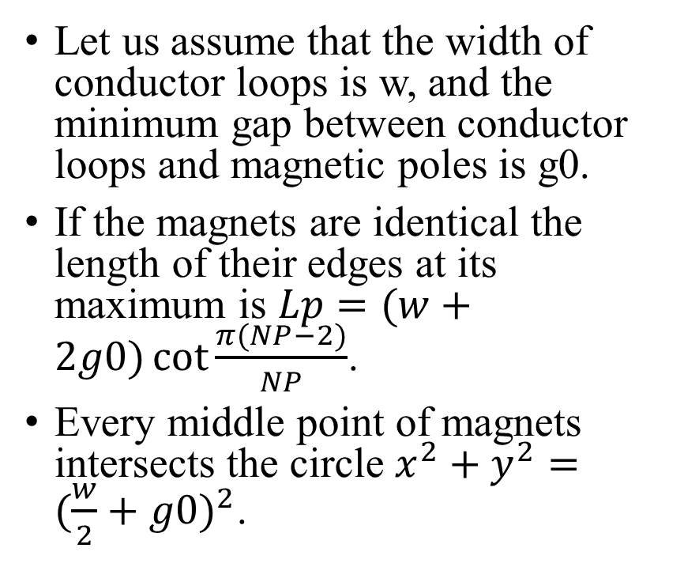
Placement of the Magnets
Let us assume that the width of conductor loops is w, and the minimum gap between conductor loops and magnetic poles is g0.
If the magnets are identical the length of their edges at its maximum is $Lp=(w+2g0)\cot{\frac{π(NP−2)}{NP}}$.
Every middle point of magnets intersects the circle $x^{2}+y^{2}={(\frac{w}{2}+g0)}^{2}$.

Slide 5
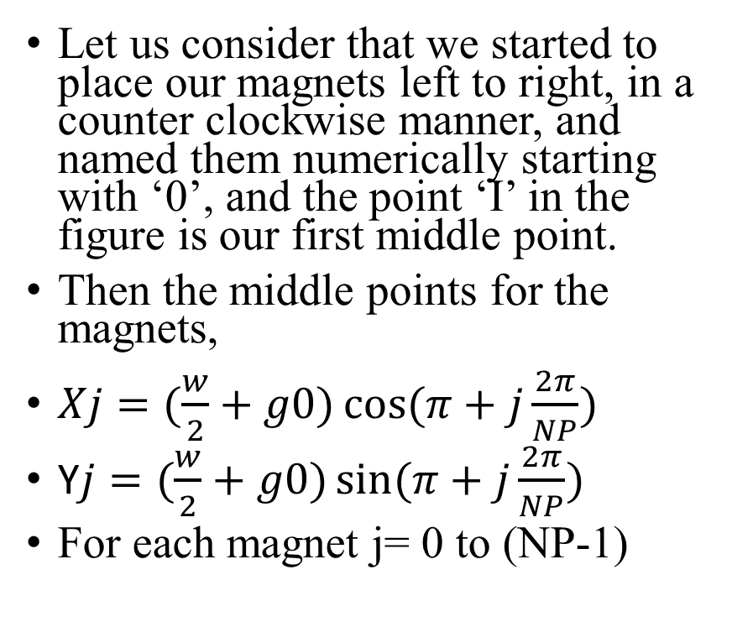
Placement of the Magnets
Let us consider that we started to place our magnets left to right, in a counter clockwise manner, and named them numerically starting with ‘0’, and the point ‘I’ in the figure is our first middle point.
Then the middle points for the magnets,
$Xj=(\frac{w}{2}+g0)\cos{(π+j\frac{2π}{NP})}$
Y$j=(\frac{w}{2}+g0)\sin{(π+j\frac{2π}{NP})}$
For each magnet j= 0 to (NP-1)

Slide 6
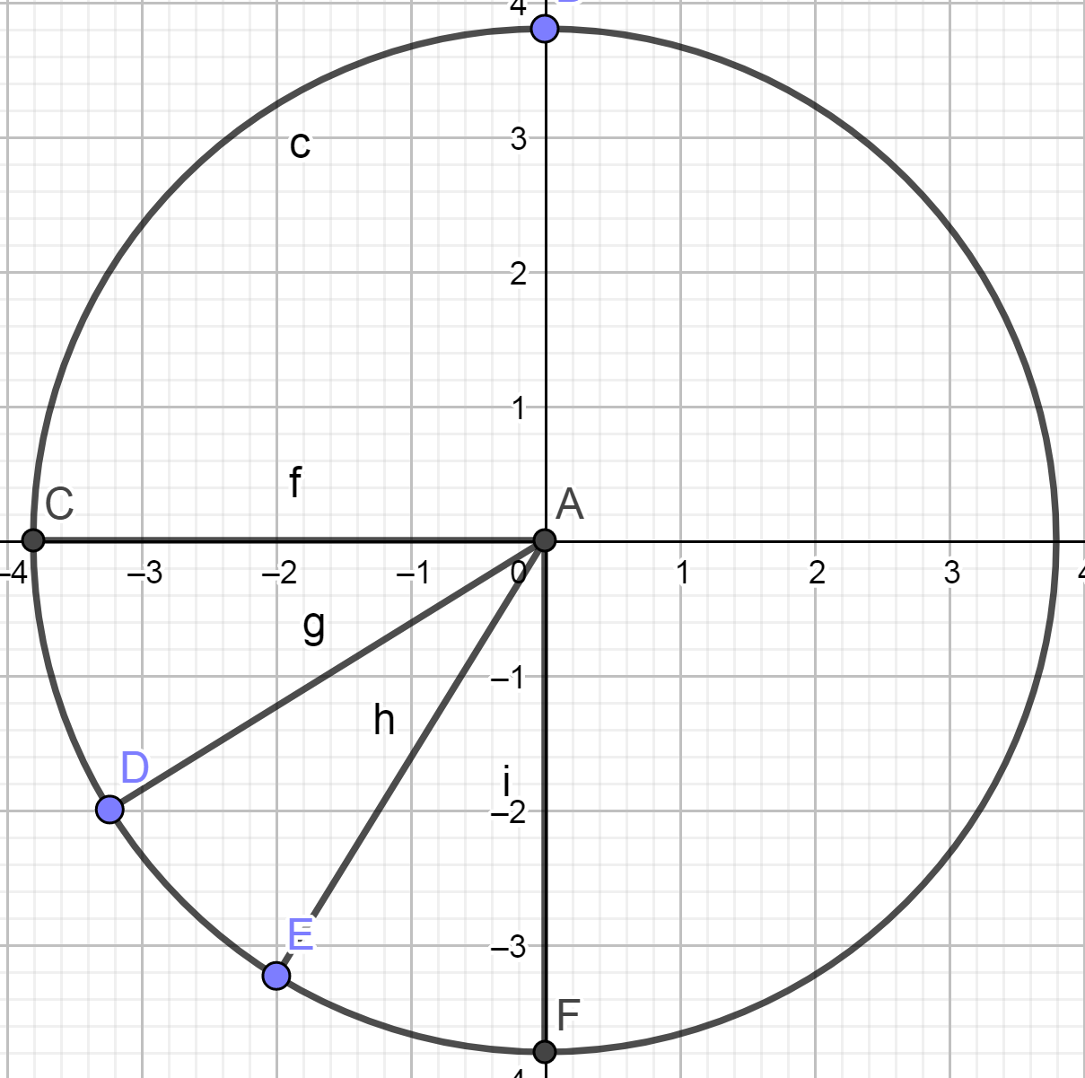
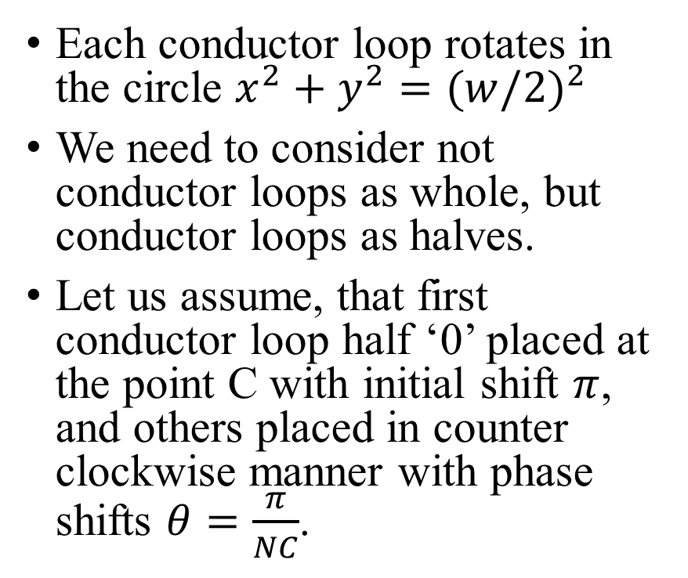
Position of Conductor Loops in Time
Each conductor loop rotates in the circle $x^{2}+y^{2}={(w/2)}^{2}$
We need to consider not conductor loops as whole, but conductor loops as halves.
Let us assume, that first conductor loop half ‘0’ placed at the point C with initial shift $π$, and others placed in counter clockwise manner with phase shifts $θ=\frac{π}{NC}$.

Slide 7

Position of Conductor Loops in Time
$Xj=(\frac{w}{2})\cos{(π+ωt+j\frac{π}{NC})}$
Y$j=(\frac{w}{2})\sin{(π+ωt+j\frac{π}{NC})}$
For each half of the conductor loop j= 0 to (2NC-1)

Slide 8
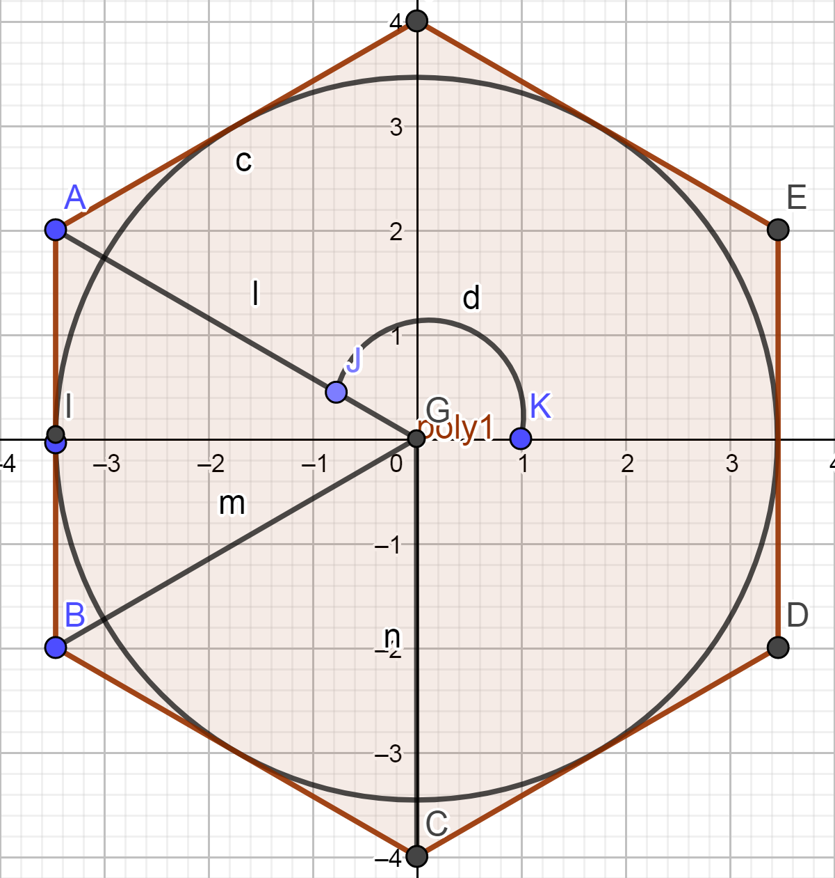
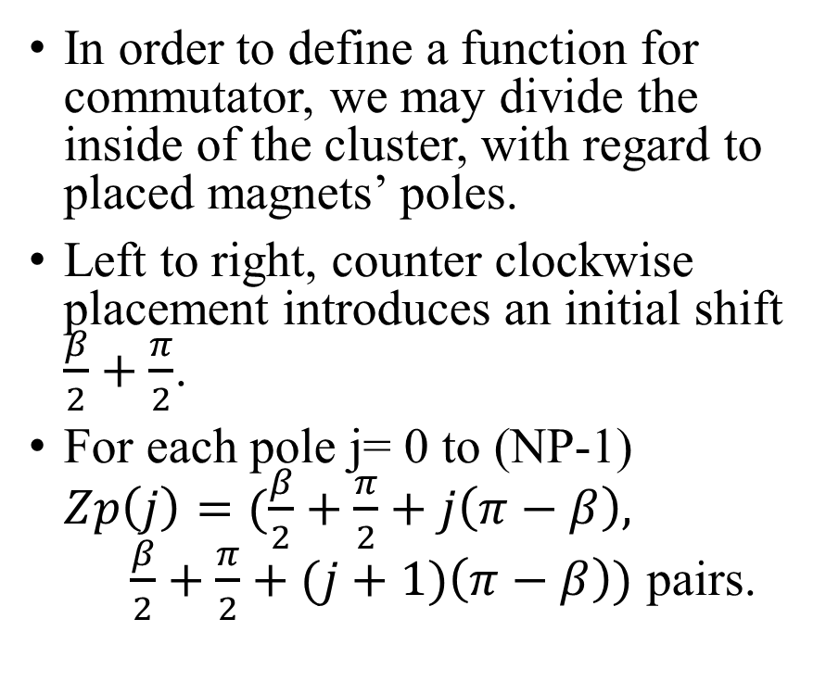
Magnetic Zones
In order to define a function for commutator, we may divide the inside of the cluster, with regard to placed magnets’ poles.
Left to right, counter clockwise placement introduces an initial shift $\frac{β}{2}+\frac{π}{2}$.
For each pole j= 0 to (NP-1) $Zp\left(j\right)=(\frac{β}{2}+\frac{π}{2}+j\left(π−β\right), \frac{β}{2}+\frac{π}{2}+(j+1)\left(π−β\right))$ pairs.

Slide 9
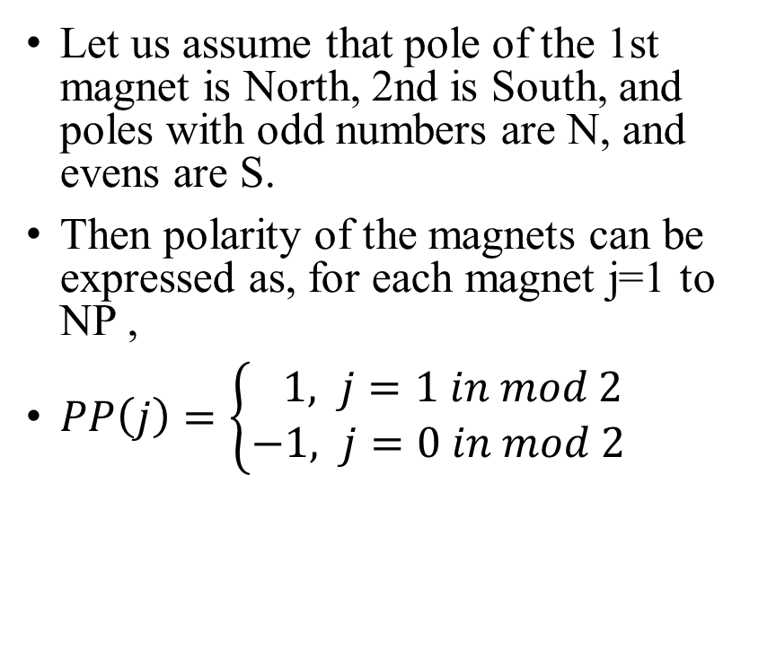
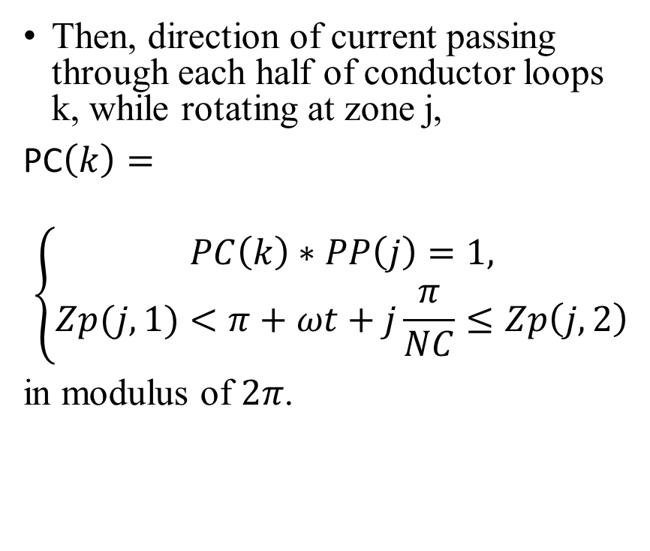
Magnetic Zones and Direction of Current
Let us assume that pole of the 1st magnet is North, 2nd is South, and poles with odd numbers are N, and evens are S.
Then polarity of the magnets can be expressed as, for each magnet j=1 to NP ,
$PP\left(j\right)=\left\{\begin{aligned} 1, j=1 in mod 2 \\ &−1, j=0 in mod 2\end{aligned}\right.$
Then, direction of current passing through each half of conductor loops k, while rotating at zone j,
PC$\left(k\right)=$
$$\left\{\begin{aligned}PC\left(k\right)∗PP\left(j\right)=1, \\ &Zp(j,1)<π+ωt+j\frac{π}{NC}≤Zp\left(j,2\right)\end{aligned}\right.$$
in modulus of $2π$.

Slide 10
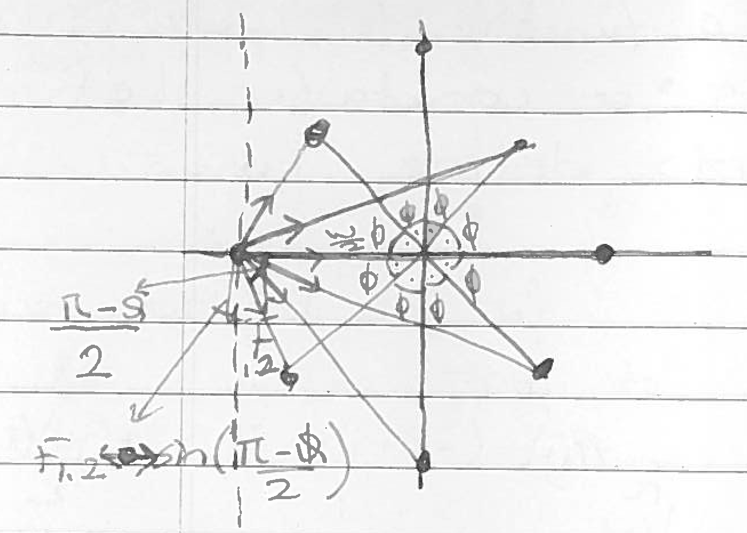
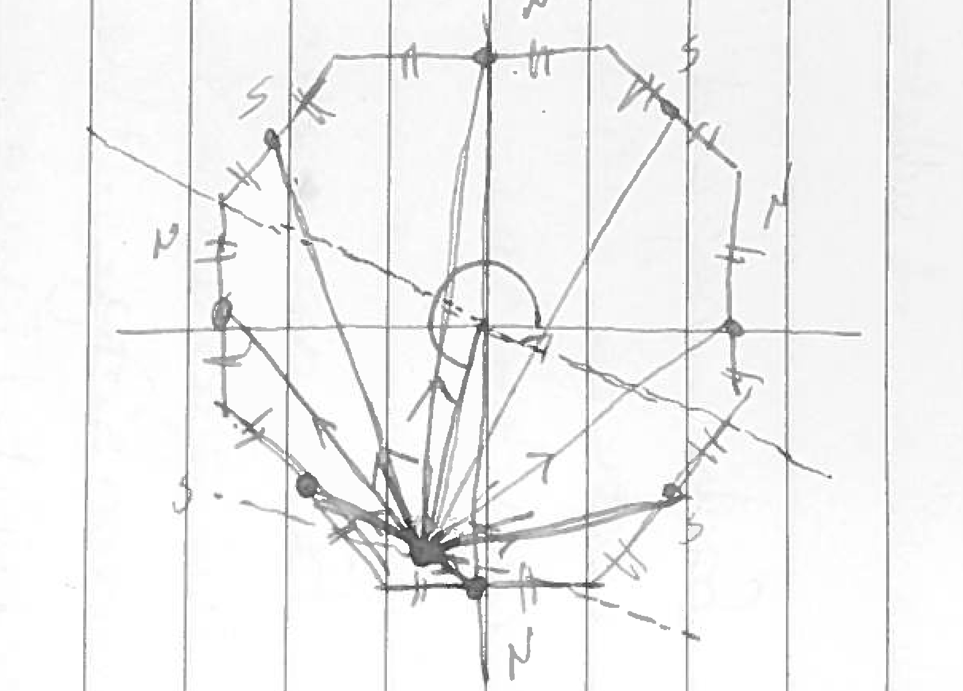
Pushes and Pulls

Slide 11
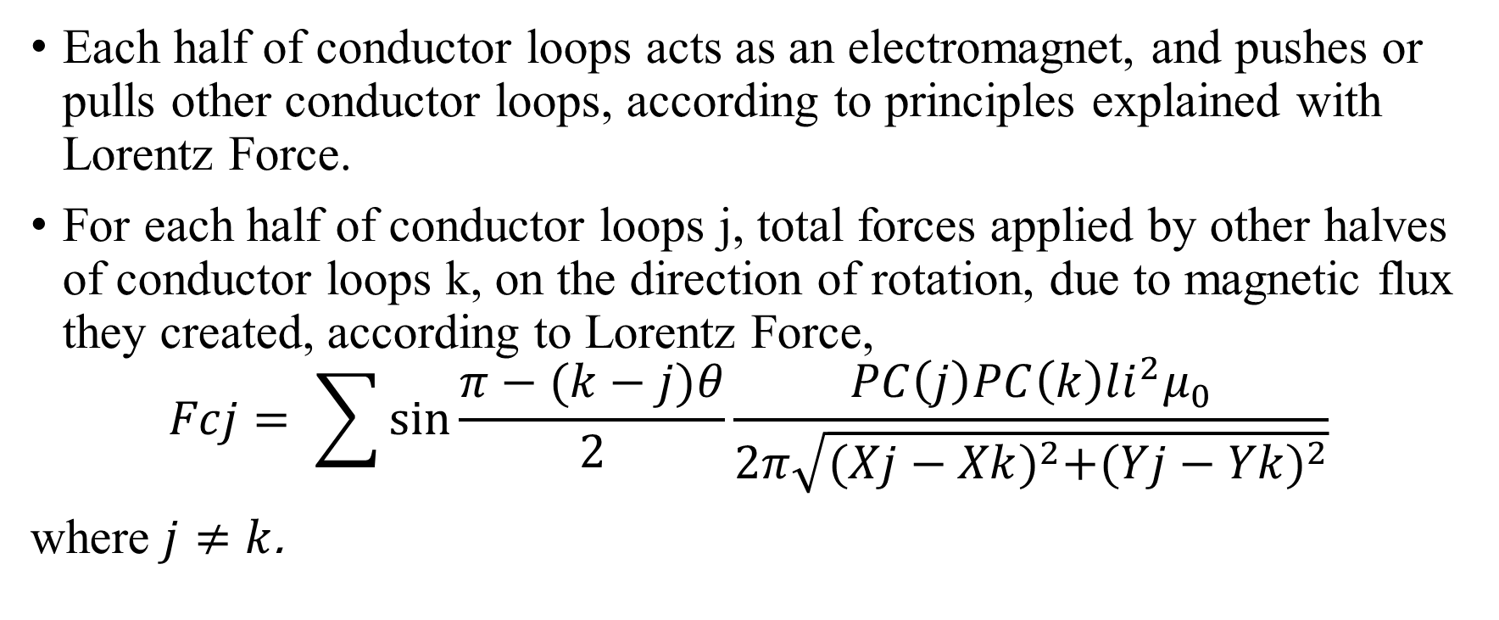
Pushes and Pulls
Each half of conductor loops acts as an electromagnet, and pushes or pulls other conductor loops, according to principles explained with Lorentz Force.
For each half of conductor loops j, total forces applied by other halves of conductor loops k, on the direction of rotation, due to magnetic flux they created, according to Lorentz Force,
$$Fcj= \sum{\sin{\frac{π−(k−j)θ}{2}\frac{PC\left(j\right)PC\left(k\right)li^{2}μ_{0}}{2π\sqrt{{(Xj−Xk)}^{2}+{(Yj−Yk)}^{2}}}}}$$
where $j≠k$.

Slide 12
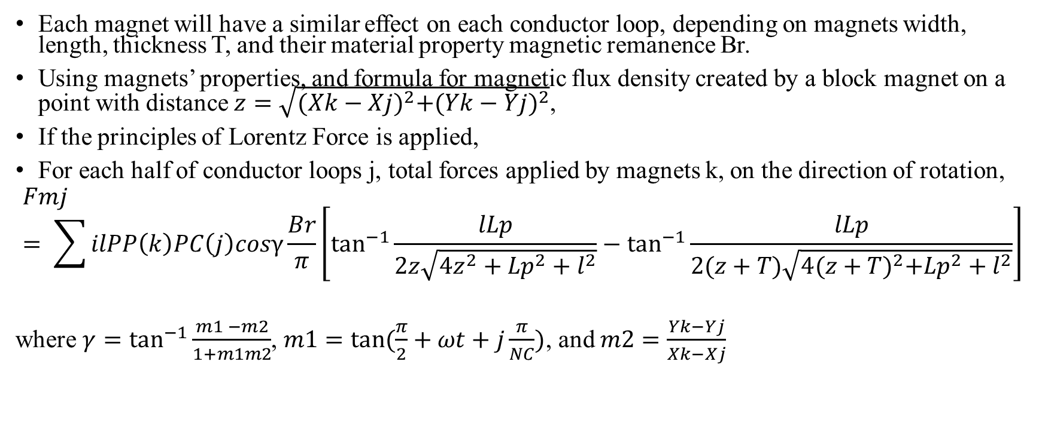
Pushes and Pulls
Each magnet will have a similar effect on each conductor loop, depending on magnets width, length, thickness T, and their material property magnetic remanence Br.
Using magnets’ properties, and formula for magnetic flux density created by a block magnet on a point with distance $z=\sqrt{{(Xk−Xj)}^{2}+{(Yk−Yj)}^{2}}$,
If the principles of Lorentz Force is applied,
For each half of conductor loops j, total forces applied by magnets k, on the direction of rotation,
$$Fmj= \sum{ilPP\left(k\right)PC\left(j\right)cosγ\frac{Br}{π}\left[\tan^{−1}{\frac{lLp}{2z\sqrt{4z^{2}+{Lp}^{2}+l^{2}}}−\tan^{−1}{\frac{lLp}{2(z+T)\sqrt{4{(z+T)}^{2}+{Lp}^{2}+l^{2}}}}}\right]}$$
where $γ=\tan^{−1}{\frac{m1 −m2}{1+m1m2}}$, $m1=\tan{(\frac{π}{2}+ωt+j\frac{π}{NC})}$, and $m2=\frac{Yk−Yj}{Xk−Xj}$

Slide 13

Pushes and Pulls
Sum of the both forces applied to each half of conductor loops is the force generated by the described permanent magnet DC motor.
$\sum_{j=1}^{2NC}{Fcj+Fmj}$.

